Slide 1
customer age vs buying analysis
TEAM MEMBERS
NIRANJANA/AI&DS/|
PADHMA BALA K/ AI&DS /|
RAKSHANA MANIKANDAN/ AI&DS /YR

Slide 2


ABSTRACT
This project analyzes the relationship between customer age groups and their purchasing behavior. By examining buying patterns across different age categories, the study helps businesses understand customer preferences, improve marketing strategies, and increase sales efficiency.

Slide 3

PROBLEM STATEMENT
Businesses often struggle to identify which age groups are more likely to purchase certain products. Without proper analysis, marketing efforts may not reach the right audience, leading to reduced sales and customer engagement.

Slide 4

OBJECTIVES
To analyze customer buying behavior based on age
To identify high-purchasing age groups
To study product preferences among different age categories
To support decision-making in marketing strategies

Slide 5

OBJECTIVES
EXPECTED OUTCOME OF THE PROJECT
To provide insights into how age influences purchasing decisions and help businesses target the right customers effectively.

Slide 6
SCOPE
This project can be used in:
Retail businesses
E-commerce platforms
Marketing analytics
Customer relationship management

Slide 7

EXISTING SYSTEM
Traditional marketing without data analysis
Generalized customer targeting
Limited understanding of customer behavior

Slide 8

PROPOSED SYSTEM
Data-driven analysis using customer data
Age-based segmentation
Visualization tools (graphs, charts)
Better targeting and personalization

Slide 9

METHODOLOGY
Collect customer data (age, purchase history)
Classify customers into age groups
Analyze buying patterns
Create visualizations (bar charts, pie charts)
Interpret results

Slide 10
TECHNOLOGY USED
TOOLS AND LANGUAGES
Python
Pandas (for data analysis)
Matplotlib / Seaborn (for visualization)
Excel / CSV datasets

Slide 11
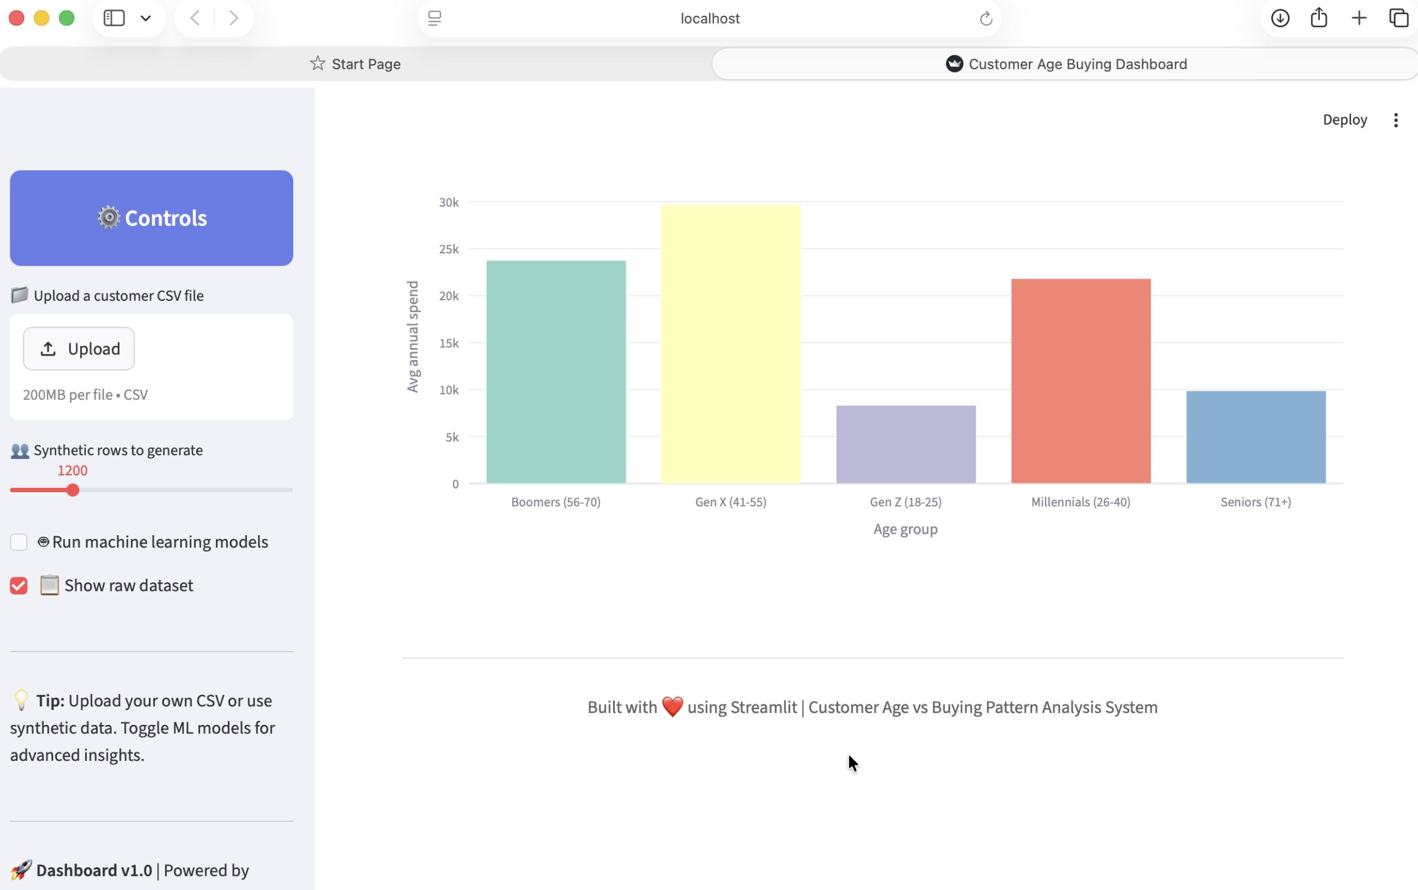
RESULTS

Slide 12
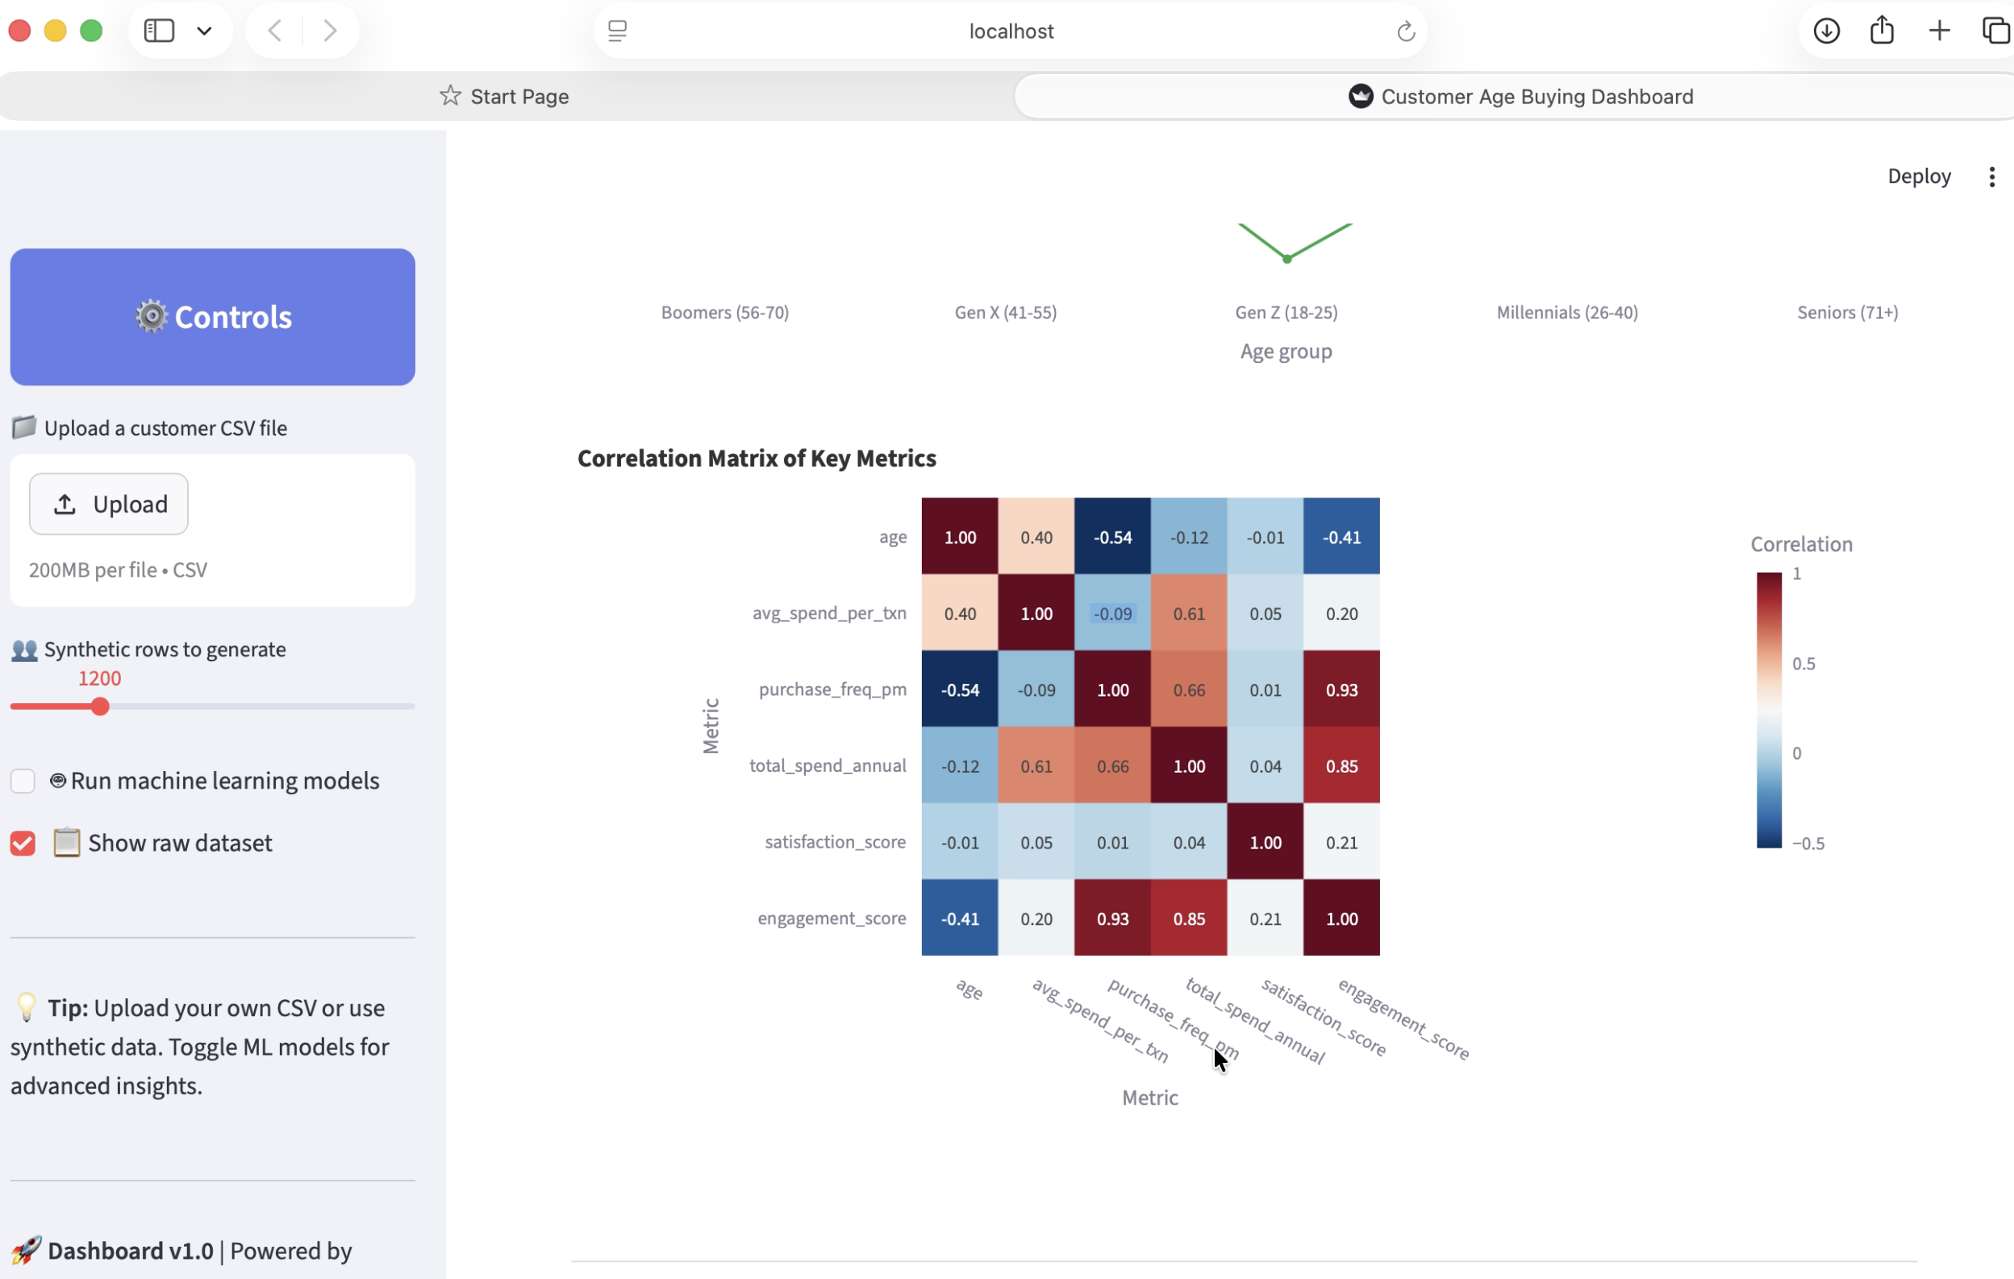
RESULTS

Slide 13
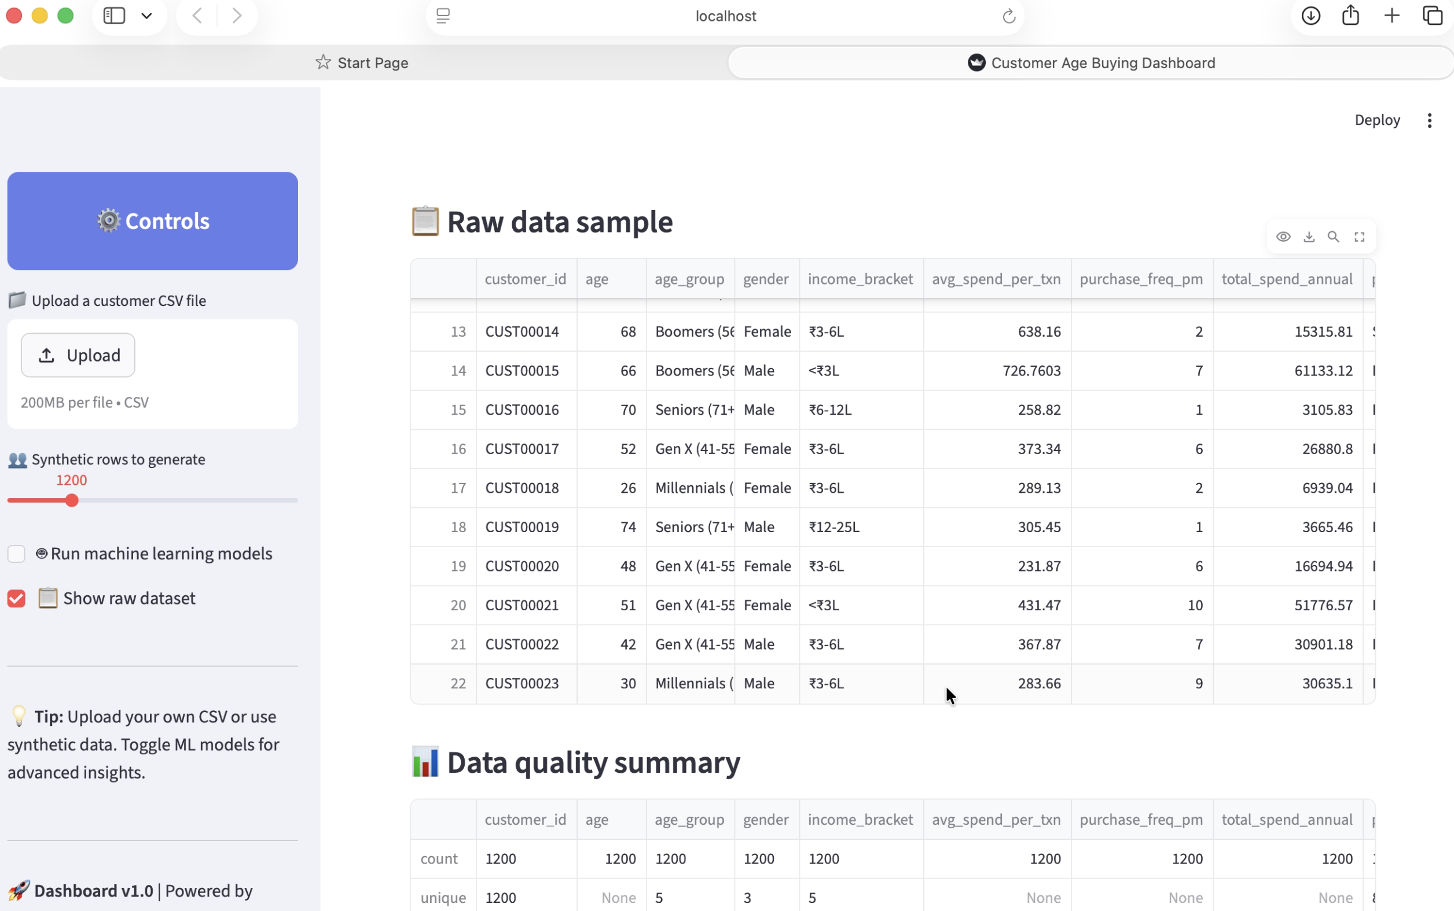
RESULTS

Slide 14
CHALLENGES
Collecting accurate data
Data cleaning and preprocessing
Handling missing values
Interpreting complex patterns

Slide 15


CONCLUSION
The project successfully demonstrates how customer age impacts buying behavior. Businesses can use these insights to target specific age groups, improve marketing strategies, and increase overall sales.

Slide 16
THANK YOU

